Slide 1
Digitalising and Automating Domain-Specific AI Model Cards for Radiotherapy
Silvia María, Herranz Hernández
BrainRain - 25th July 2025

Slide 2
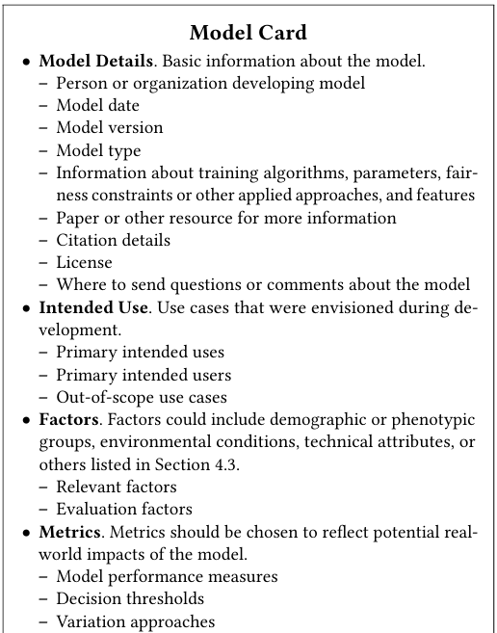
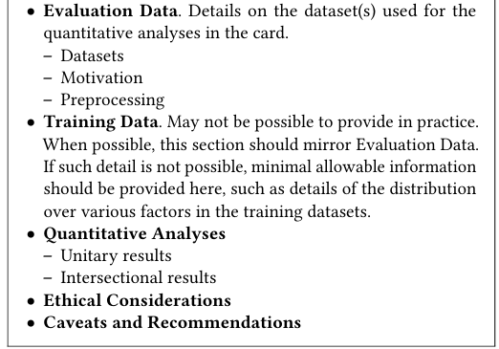

What is a Model Card?
[1]

Slide 3
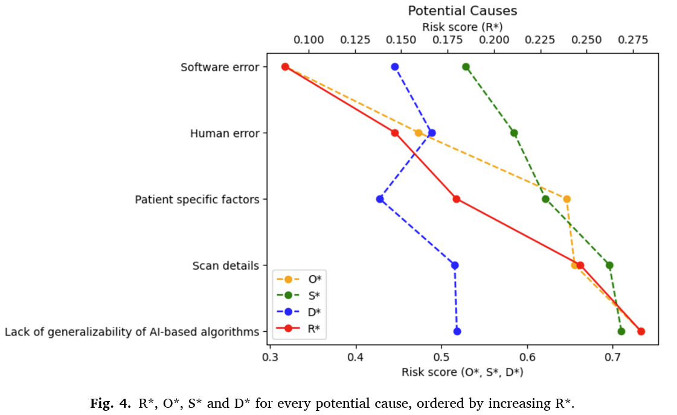
Why Transparency is Critical for Safe AI in RT?
Top Causes of Risk
Lack of model generalizability
Human error in use or oversight
Scan and patient-specific factors
Top Effects Observed
Poor segmentation or planning
Incorrect treatment setup
Treatment delays or safety risks
[2]

Slide 4
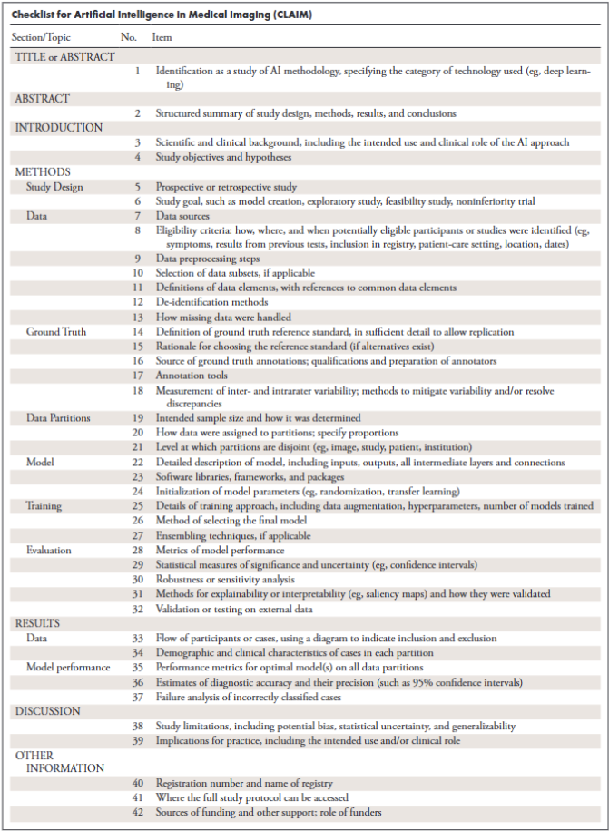
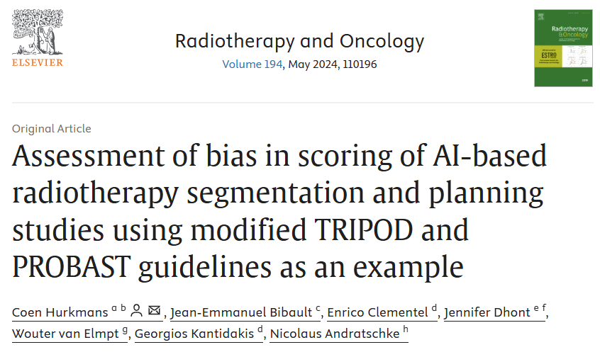
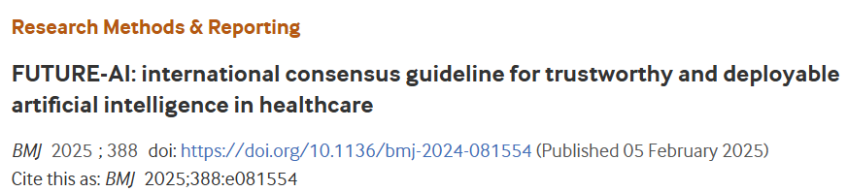
How to improve Transparency?
General-purpose tools for model and data reporting
Health-care specific reporting guidelines
Guidelines (checklist) for model & data reporting in research (journal articles, clinical trials…)
Recommendations for model development, validation and clinical implementation
Regulations (MDR, EU AI Act, CE / FDA mark, …)
[3], [4], [5]

Slide 5

Why Standardization matters in Radiotherapy AI?
[6]

Slide 6
ESTRO AI focus group approach (I)
03/2024 Review existing tools + examples from the group (e.g. commission reports)
07/2024 First proposal of information fields by the groups
01/2025 Final model card (v6) sent to external reviewers from clinics and industry
09/2024 Start review rounds for reaching consensus
04/2024 RT domain-specific groups:
Image conversion (synthetic CT)
Auto - segmentation
Dose prediction / auto-planning

Slide 7
ESTRO AI focus group approach (II)
Unified card for research and commercial models, using REQUIRED(*) and OPTIONAL fields
6-level structure
0) Card metadata, information about the card (e.g. versioning)
1) Model basic information, main information to use the model (e.g. model scope, limitations,...)
2) Technical specifications (i.e. model pipeline, learning architecture, software and hardware),
3) Training data, methodology, and information, info about training and validation data,
4) Evaluation data, methodology, and results / commissioning, with possibility of adding different evaluations
5) Other considerations, including fields about ethical use, risk analysis, and monitoring
Color code for application-specific fields
Task 1 | Image-to-image translation
Task 2 | Segmentation
Task 3 | Auto-planning / Dose prediction
Generic | Fields generic to any task
7

Slide 8
ESTRO AI focus group approach (III)
Model Card Template (.docx) – Current Version
8

Slide 9
Motivation – why digitalize the Model Card?
Word Format
JSON
Hugging Face page
9

Slide 10
Interactive Tool for Creating Digital Model Cards
10

Slide 11
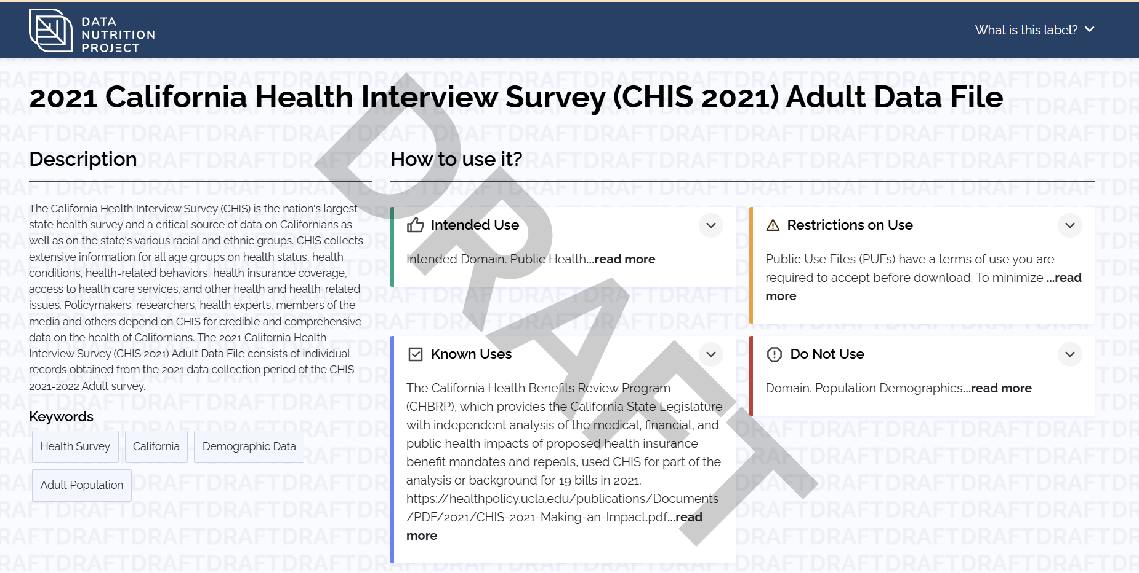
Next steps, Challenges
Next steps:
Error-control
Human readable JSON export
PDF generation
New task-specific section: “Other”
Summary visualization
Challenges:
Ensuring accuracy of user input
Balancing flexibility with standardization
It might be too long to fill in
11

Slide 12

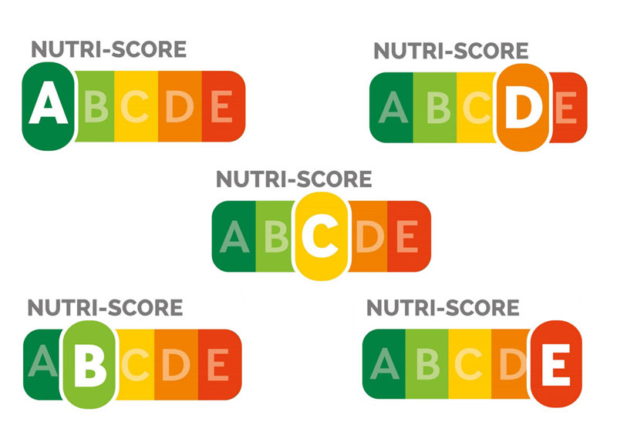

Future Ideas
Future Ideas:
Using the Model Card Before the Model Exists
Applying the Tool to a Real Model
Automatic Model Comparison and performance indicators based on Model Cards
12

Slide 13

Discussion, questions, suggestions…

Slide 14
Bibliography (I)
[1] Mitchell, M., Wu, S., Zaldivar, A., Barnes, P., Vasserman, L., Hutchinson, B., ... & Gebru, T. (2019, January). Model cards for model reporting. In Proceedings of the conference on fairness, accountability, and transparency (pp. 220-229).
[2] De Kerf, G., Barragán-Montero, A., Brouwer, C. L., Pisciotta, P., Biston, M. C., Fusella, M., ... & Janssen, T. M. (2025). Multicentre prospective risk analysis of a fully automated radiotherapy workflow. Physics and Imaging in Radiation Oncology, 34, 100765.
[3] Hurkmans, C., Bibault, J. E., Clementel, E., Dhont, J., van Elmpt, W., Kantidakis, G., & Andratschke, N. (2024). Assessment of bias in scoring of AI-based radiotherapy segmentation and planning studies using modified TRIPOD and PROBAST guidelines as an example. Radiotherapy and Oncology, 194, 110196.
[4] Mongan, J., Moy, L., & Kahn Jr, C. E. (2020). Checklist for artificial intelligence in medical imaging (CLAIM): a guide for authors and reviewers. Radiology: Artificial Intelligence, 2(2), e200029.
[5] Lekadir, K., Frangi, A. F., Porras, A. R., Glocker, B., Cintas, C., Langlotz, C. P., ... & Starmans, M. P. (2025). FUTURE-AI: international consensus guideline for trustworthy and deployable artificial intelligence in healthcare. bmj, 388.

Slide 15
Bibliography (II)
[6] de Biase, A., Sourlos, N., & van Ooijen, P. M. (2022, October). Standardization of artificial intelligence development in radiotherapy. In Seminars in radiation oncology (Vol. 32, No. 4, pp. 415-420). WB Saunders.

